Slide 1


Interpolation Methods for analyzing under-sampled impedance data
Wissam Razouki
CSE 3802

Slide 2
introduction

Slide 3
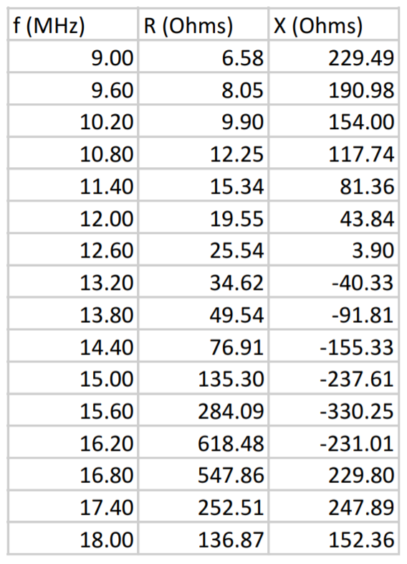
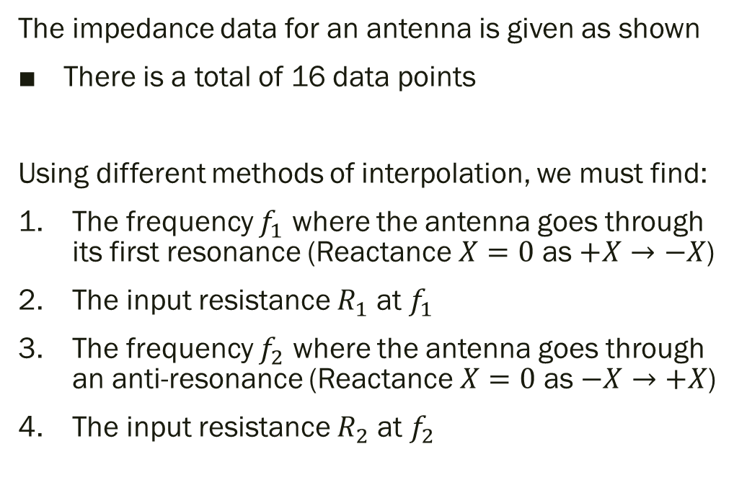
The Problem
The impedance data for an antenna is given as shown
There is a total of 16 data points
Using different methods of interpolation, we must find:
The frequency $f_{1}$ where the antenna goes through its first resonance (Reactance $X=0$ as $+X→−X$)
The input resistance $R_{1}$ at $f_{1}$
The frequency $f_{2}$ where the antenna goes through an anti-resonance (Reactance $X=0$ as $−X→+X$)
The input resistance $R_{2}$ at $f_{2}$

Slide 4
Methods Used
Reference method:
MATLAB Cubic Spline Interpolation
Experimental methods:
Newton Polynomial Interpolation
Quadratic Spline Interpolation (with Clamped Boundary)

Slide 5
testing method and solutions

Slide 6
The Reference Method
Since the exact solutions to the problem are not given, we need a way to empirically evaluate and compare our experimental methods.
An alternative way to do this is by using a reference method:
MATLAB provides the built-in function interp1(…) for interpolating over one-dimensional data using various methods
In order to obtain maximum possible accuracy, we must interpolate over the entire dataset using cubic splines
First, we interpolate f vs. X and find the f values
Next, we interpolate f vs. R and find the R values at the f values found previously
The resulting plots for “f vs. X” and “f vs. R” (with solutions marked) are shown below

Slide 7
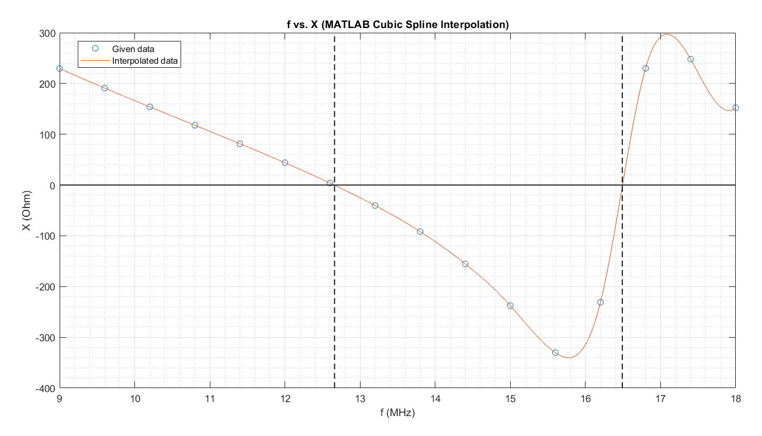


$$f_{1}≈12.66$$
$$f_{2}≈16.49$$

Slide 8
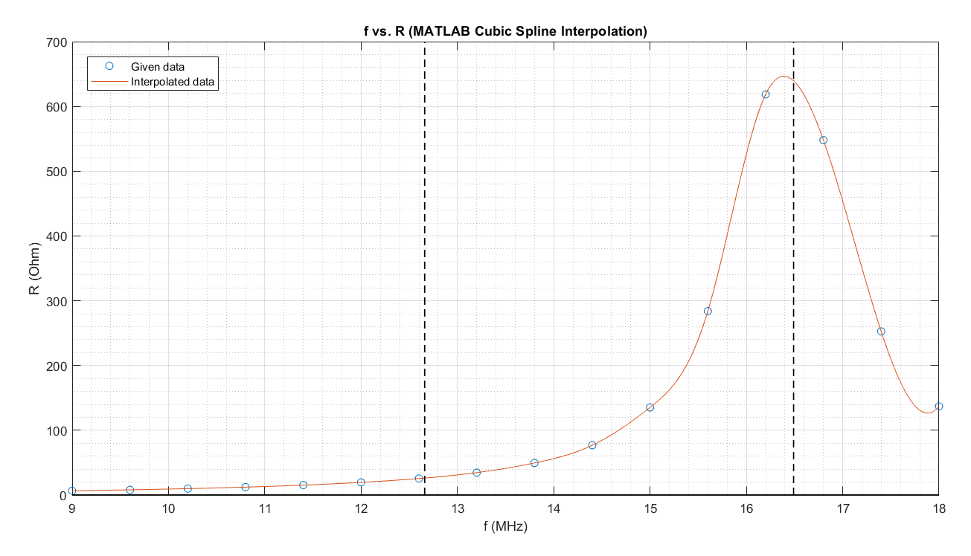


$$R_{2}≈639.6$$
$$R_{1}≈26.27$$

Slide 9
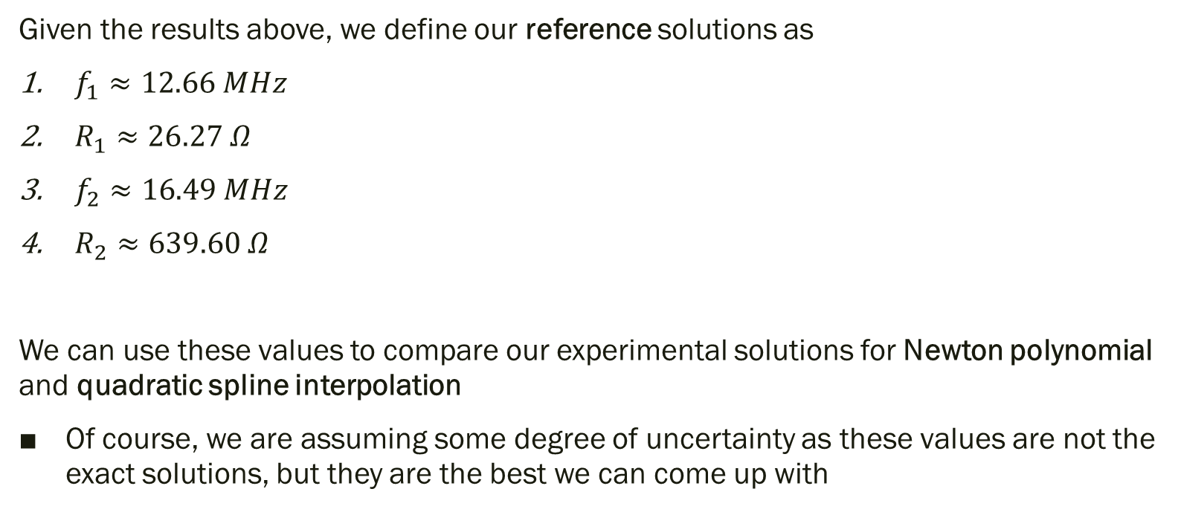
The Reference Solutions
Given the results above, we define our reference solutions as
$f_{1}≈12.66 MHz$
$R_{1}≈26.27 Ω$
$f_{2}≈16.49 MHz$
$R_{2}≈639.60 Ω$
We can use these values to compare our experimental solutions for Newton polynomial and quadratic spline interpolation
Of course, we are assuming some degree of uncertainty as these values are not the exact solutions, but they are the best we can come up with

Slide 10
Experimental results and analysis

Slide 11
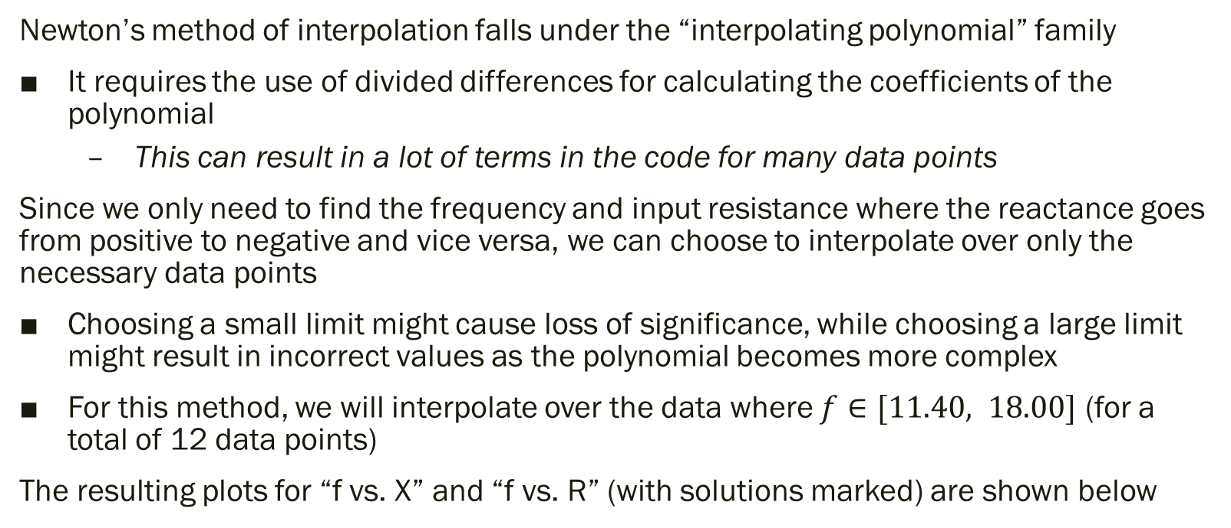
Newton Polynomial
Newton’s method of interpolation falls under the “interpolating polynomial” family
It requires the use of divided differences for calculating the coefficients of the polynomial
This can result in a lot of terms in the code for many data points
Since we only need to find the frequency and input resistance where the reactance goes from positive to negative and vice versa, we can choose to interpolate over only the necessary data points
Choosing a small limit might cause loss of significance, while choosing a large limit might result in incorrect values as the polynomial becomes more complex
For this method, we will interpolate over the data where $f∈[11.40, 18.00]$ (for a total of 12 data points)
The resulting plots for “f vs. X” and “f vs. R” (with solutions marked) are shown below

Slide 12
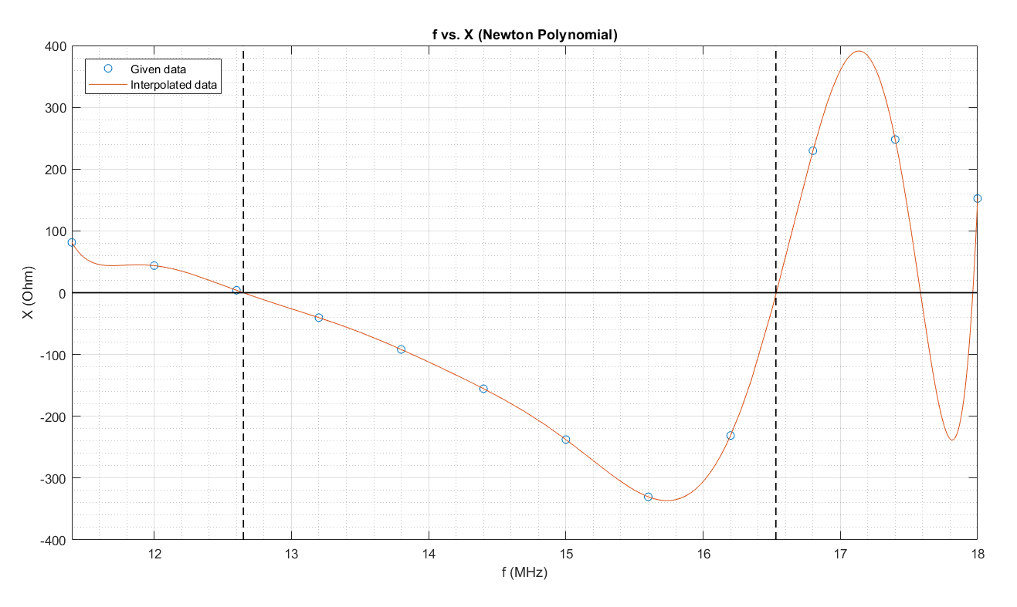


$$f_{1}≈12.65$$
$$f_{2}≈16.53$$

Slide 13
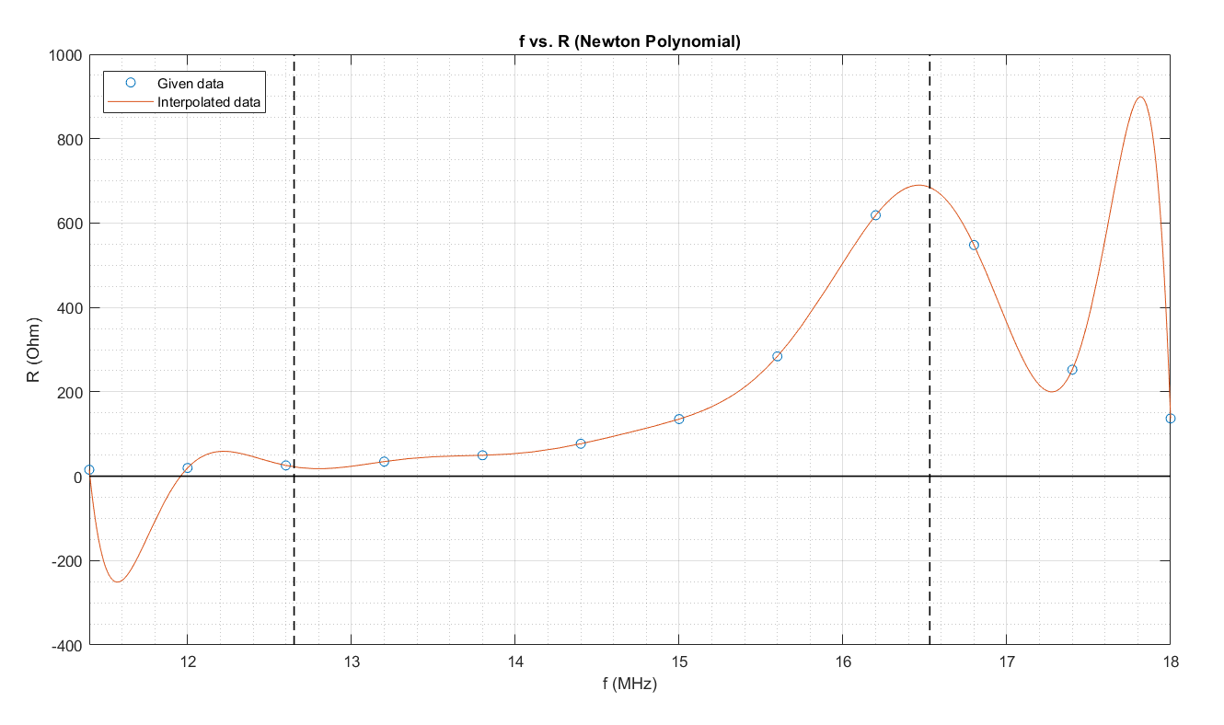


$$R_{2}≈684.5$$
$$R_{1}≈22.07$$

Slide 14
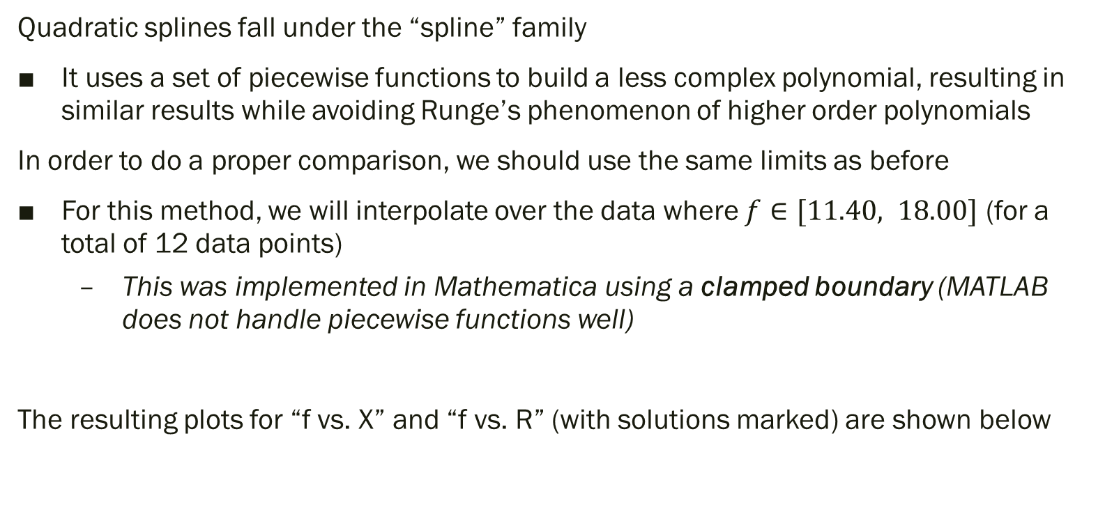
Quadratic Spline
Quadratic splines fall under the “spline” family
It uses a set of piecewise functions to build a less complex polynomial, resulting in similar results while avoiding Runge’s phenomenon of higher order polynomials
In order to do a proper comparison, we should use the same limits as before
For this method, we will interpolate over the data where $f∈[11.40, 18.00]$ (for a total of 12 data points)
This was implemented in Mathematica using a clamped boundary (MATLAB does not handle piecewise functions well)
The resulting plots for “f vs. X” and “f vs. R” (with solutions marked) are shown below

Slide 15
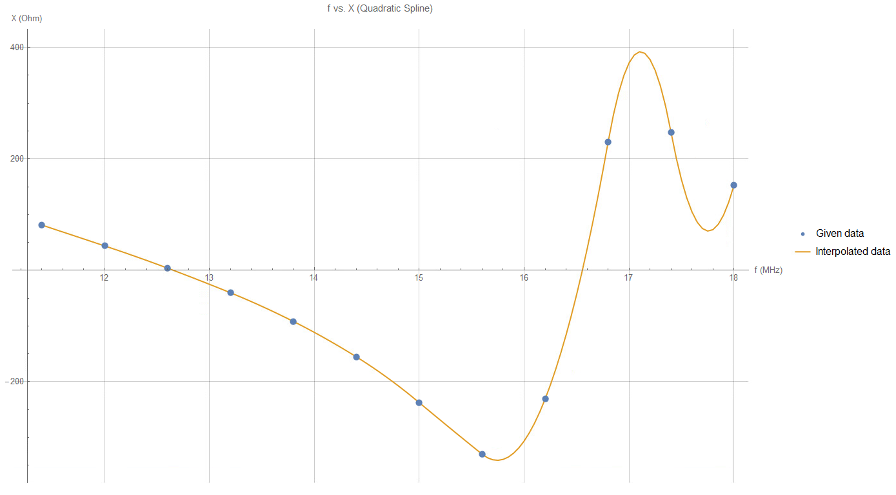


$$f_{1}≈12.65$$
$$f_{2}≈16.55$$

Slide 16
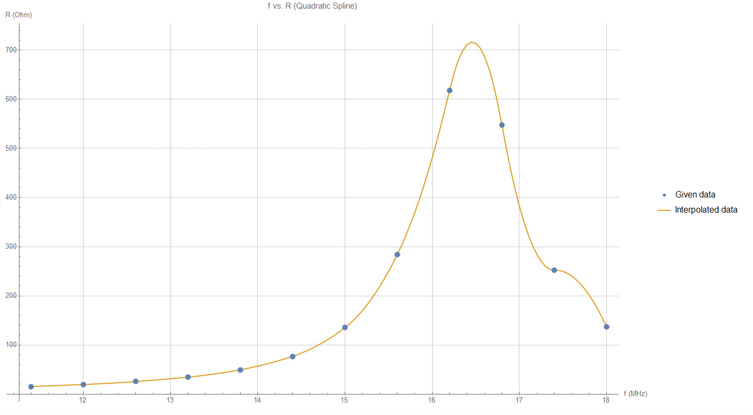


$$R_{2}≈703.45$$
$$R_{1}≈26.4$$

Slide 17
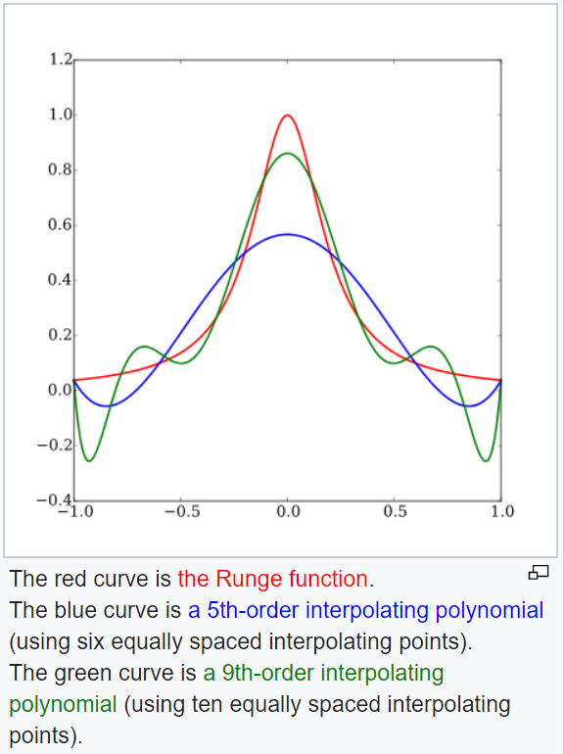
Graphical Analysis
Looking at the graphs above, we notice that the “waves” in the Newton polynomial are much greater at the endpoints compared to the quadratic spline
This is a simple case of Runge’s phenomenon, which shows that interpolating polynomials of a higher degree tend to oscillate more at the edges of the interval
In this case, we are analyzing a 11th degree Newton polynomial vs. a 2nd degree quadratic spline polynomial
Runge’s phenomenon (from Wikipedia)

Slide 18
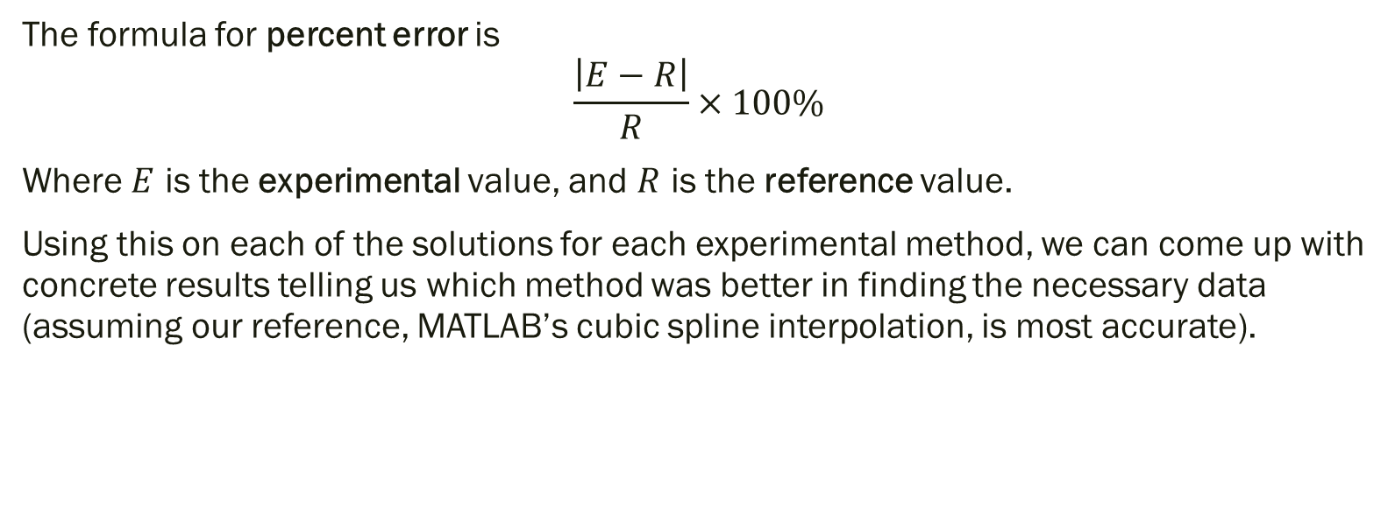
Error Analysis
The formula for percent error is
$$\frac{\left|E−R\right|}{R}×100\%$$
Where $E$ is the experimental value, and $R$ is the reference value.
Using this on each of the solutions for each experimental method, we can come up with concrete results telling us which method was better in finding the necessary data (assuming our reference, MATLAB’s cubic spline interpolation, is most accurate).

Slide 19
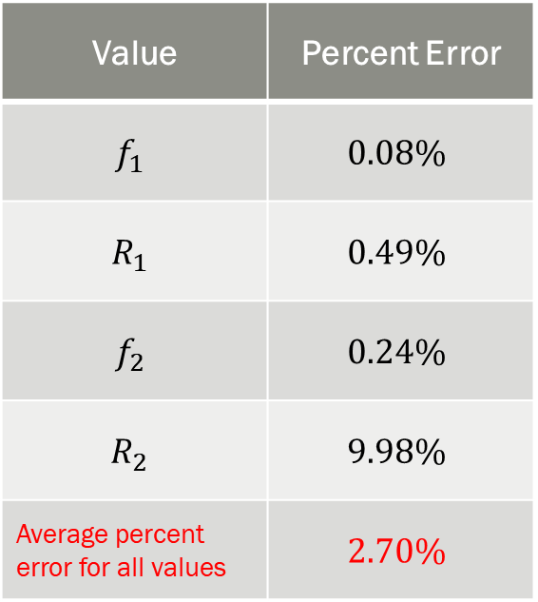
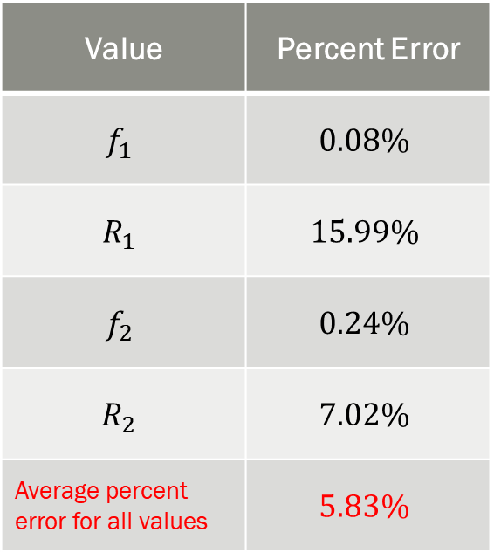
Error Analysis Results
Newton Polynomial
Quadratic Spline
Value | Percent Error
$$f_{1}$$ | $$0.08\%$$
$$R_{1}$$ | $$15.99\%$$
$$f_{2}$$ | $$0.24\%$$
$$R_{2}$$ | $$7.02\%$$
Average percent error for all values | $$5.83\%$$
Value | Percent Error
$$f_{1}$$ | $$0.08\%$$
$$R_{1}$$ | $$0.49\%$$
$$f_{2}$$ | $$0.24\%$$
$$R_{2}$$ | $$9.98\%$$
Average percent error for all values | $$2.70\%$$

Slide 20
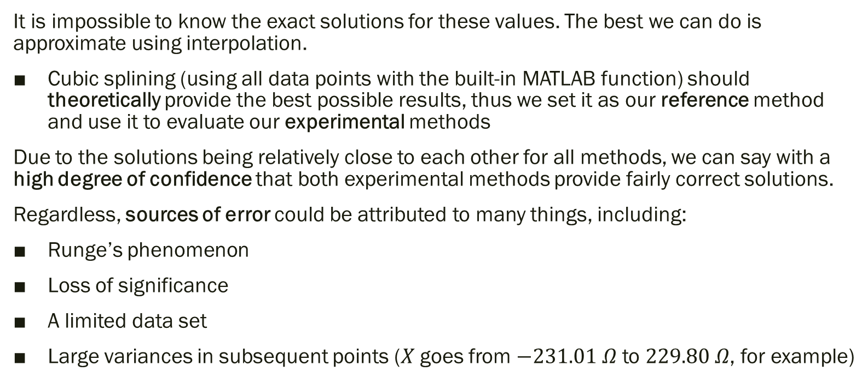
Risk, Challenges, and Sources of Error
It is impossible to know the exact solutions for these values. The best we can do is approximate using interpolation.
Cubic splining (using all data points with the built-in MATLAB function) should theoretically provide the best possible results, thus we set it as our reference method and use it to evaluate our experimental methods
Due to the solutions being relatively close to each other for all methods, we can say with a high degree of confidence that both experimental methods provide fairly correct solutions.
Regardless, sources of error could be attributed to many things, including:
Runge’s phenomenon
Loss of significance
A limited data set
Large variances in subsequent points ($X$ goes from $−231.01 Ω$ to $229.80 Ω$, for example)

Slide 21
Further Analysis and Conclusions
According to these results, we can conclude that quadratic splining is better suited for this problem than Newton polynomial (on average).
This is to be expected, as quadratic splining uses a lower order polynomial, resulting in less variation in the data
For a simple problem like this (where we only need to query a few specific points), both methods provide sufficiently accurate results.
However, were we given even more data (hundreds or even thousands of data points), and tasked with providing an interpolation function for finding sufficiently accurate data at all inputs, quadratic splining becomes significantly more appealing than Newton polynomial.

